Slide 1
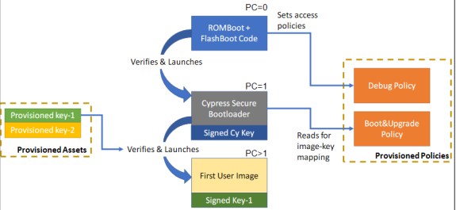
Embedded Security Showcase on PSOC6 (ESSOP)
27.04.20
Team Meeting – Week 3
Aadarsh Kumar Singh , 766499
Hari Krishna Yelchuri , 766518
Vaishnavi Sankaranarayanan , 766486

Slide 2
Content
  Minutes of Meeting – 06.05.2020 -
  User Story 1- Create a makefile project for PSoC64
  User Story 2- Create secure communication showcase using PSoC64
  User Story 3- Analyse the crypto-hardware present on PSoC64
  Clarification Required
H_DA Embedded Systems and Microelectronics

Slide 3
Understanding security of PSoC64 Kit
User story link : https://aadarsh.atlassian.net/browse/ESSOP-7
Show Demo :
  please find the docs: in 30_Architecture\Information\Concepts\PSoC64_SecureBoot
Resolved , To be closed after review
H_DA Embedded Systems and Microelectronics

Slide 4
Feasible open source crypto library
User story link : https://aadarsh.atlassian.net/browse/ESSOP-6
please find the docs: in 30_Architecture\Information\Concepts\Cryptography_Algorithms
Resolved , To be closed after review
H_DA Embedded Systems and Microelectronics

Slide 5
Analyze the mbed Environment Workflow
User Story link : https://aadarsh.atlassian.net/browse/ESSOP-8
Show demo to add new source and toolchain flow
In progress still
H_DA Embedded Systems and Microelectronics

Slide 6
Possible security showcase concepts.
A document has been created for listing of possible security showcase concepts.
one possible use case was analysed and UML has been attached.
  Find the document in location: : 30_Architecture\Information\Concepts\Security_UseCase_Concept
H_DA Embedded Systems and Microelectronics

Slide 7
Clarifications Needed
How to proceed further for development of PSoC64 ?
Any updates from Mr.Wech
Our next steps
H_DA Embedded Systems and Microelectronics

